Slide 1


Project on Content Aware Image Resizing

Slide 2
SUPERVISOR
Image Processing Projecct Defense 2O18
Semester 1, MAIA, M-1
Dro Désiré Sidibé
Mojdeh Rastgoo
Guillaume Lemaitre
Group Members
Md. Kamrul Hasan MAIA, M-1
Fakrul Islam Tushar MAIA, M-1

Slide 3
Contents
Biomedical Engineering
Biopotentials
Available Biopotential LAB Equipment Problem
Project Idea
Block Diagram of the project
RTR Module Configuration
Hand on skill Enhancement
Output of ECG,EEG and EMG
Cost of the Project
Software Alternative
Limitation & Solution
Student Survey
Reference

Slide 4
What is Content Aware Image Resizing ??
Resizing of a image to a very different aspect ratio without destroying the useful object in the image.
Resizing the Image
Preserving the important Content
Removing the less important Contents
Getting the Resized Image

Slide 5
OBJECTIVE OF THE PROJECT
Resizing of Images Claverly
1
2
3
Get Targer Image
Image Resizing
Get Resized Imahe

Slide 6
Different Methods for Image Resizing
Cropping– Removes Meaningful Contents
Stretching– Distort the Image
Seam Carving– Removes Less Important Contents.

Slide 7
What is Image Seam Carving ??
Seam carving allows resizing the image removing the less important contents and conserving the size and shape of the important contents.
Follows simple data Structure.
Compute the Color Map
Remove or insert lowest energy path of pixel or seams from top to bottom or left to right
Preserve the Highest Energy Pixel paths or seams.

Slide 8
Seam Carving Applications
Seam Carving
Seam Removing/ Image Shrinking
Seam Adding/ Image Enlarging
Add Positive / Negative Energy
Fig.1: Basic Functionalities of Seam Carving .

Slide 9
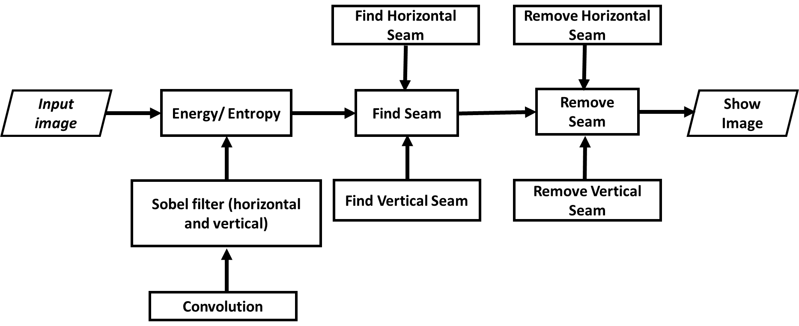
Seam Removing/ Image Shrinking block diagram
Fig.2: Seam Removing/ Image Shrinking Block Diagram .

Slide 10

Seam Adding/ Image Enlarging block diagram
Fig.3: Seam Adding/ Image Enlarging Block Diagram .
.

Slide 11
Different Methods to find Gradient based Energy
Laplacian edge Operator
Sobel Operator

Slide 12
Reason to Select Sobel Filter
Compared to a Laplacian edge operator, Sobel operator has distinct advantages
It’s a Bar Detector rather than point Detector.
Provides Edge direction as well Edge Magnitude
Easy to implement in Hardware.
Fig.2: Block diagram of the project.

Slide 13
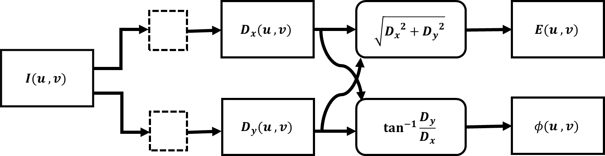
Computing Energy Using Sobel Filter
Fig.2: Block diagram of the project.

Slide 14
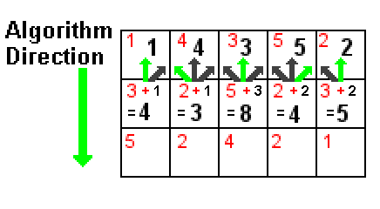
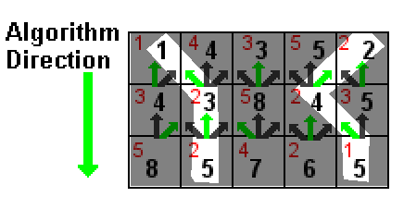
Find Seam

Slide 15
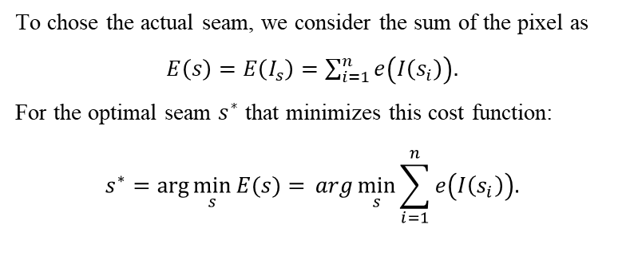
Seam Removing Algorithm
To chose the actual seam, we consider the sum of the pixel as
$E\left(s\right)=E\left(I_{s}\right)=\sum_{i=1}^{n}{e\left(I\left(s_{i}\right)\right).}$
For the optimal seam $s^{∗}$ that minimizes this cost function:
$$s^{∗}=\arg{\min_{s}{E(s)}{=} arg\min_{s}{\sum_{i=1}^{n}{e\left(I\left(s_{i}\right)\right).}}}$$
When the number of target pixel will be increase, exponential increase of possible seam that makes
impractical search.
To solve this we need dynamic programing.
Break into a collection of simpler sub-problems and solving each of those sub-problems just once.
The next time the same sub-problem occurs, instead of recomputing its solution, one simply looks
up the previously computed solution.
Thus saving of computation time.

Slide 16
Seam Adding Algorithm

Slide 17
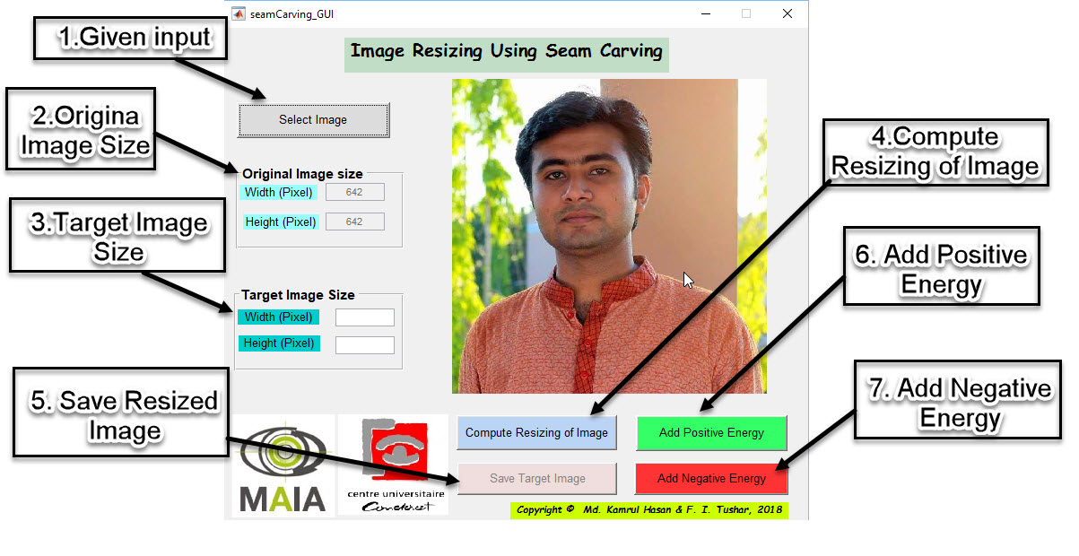
Implementation of Graphical User Interface
Fig.3: Block diagram of RTR module.

Slide 18
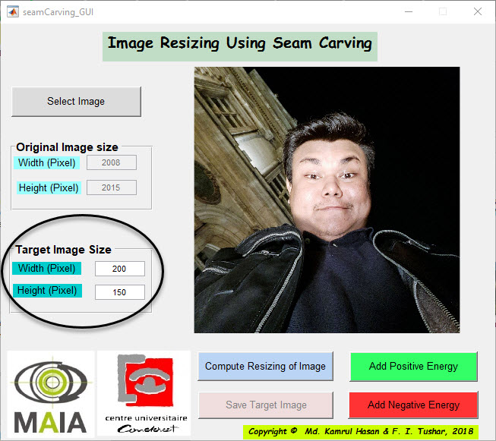
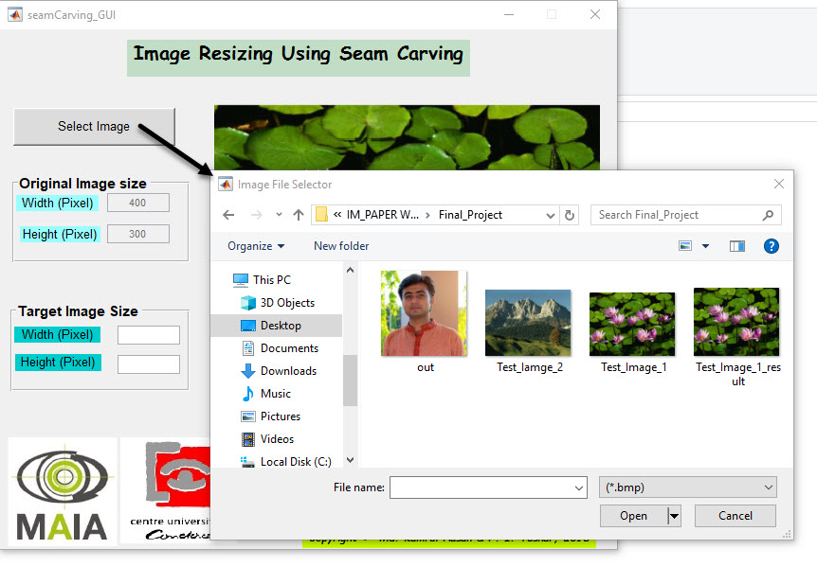
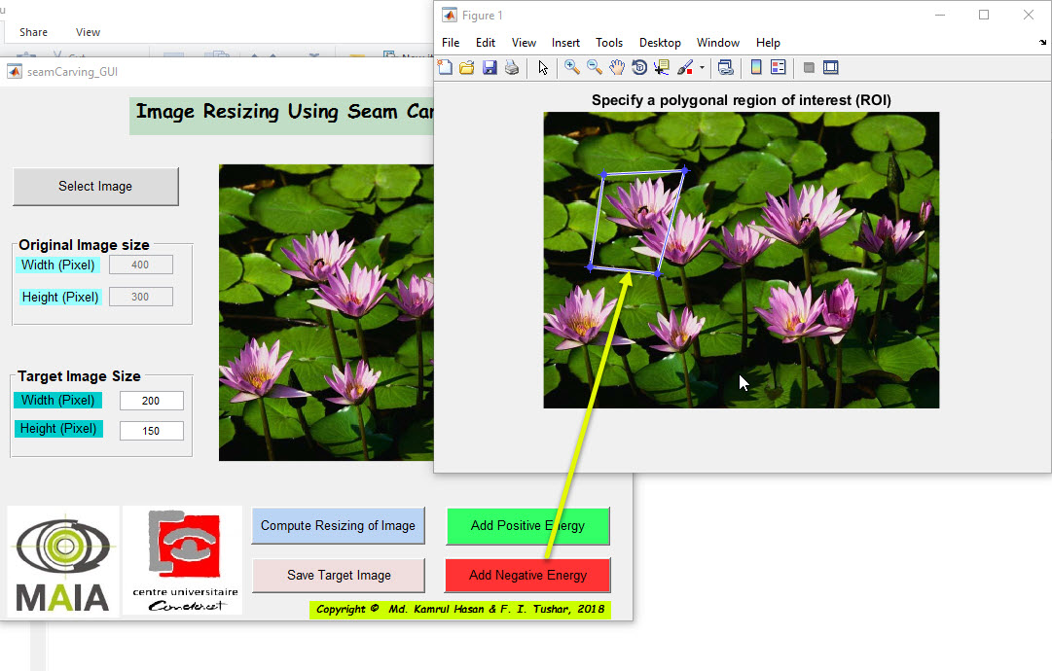
DESIGNED PROTOTYPE
Fig.5: Prototype of RTR Module.

Slide 19
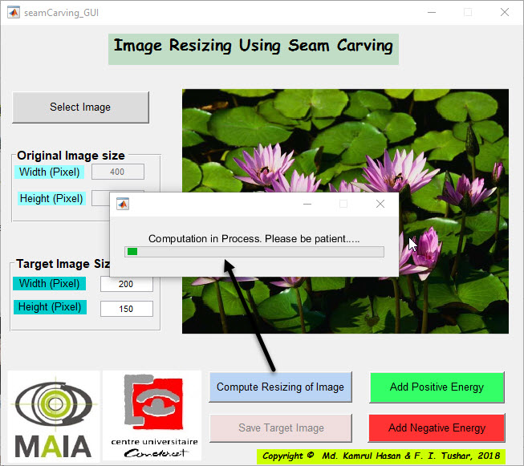
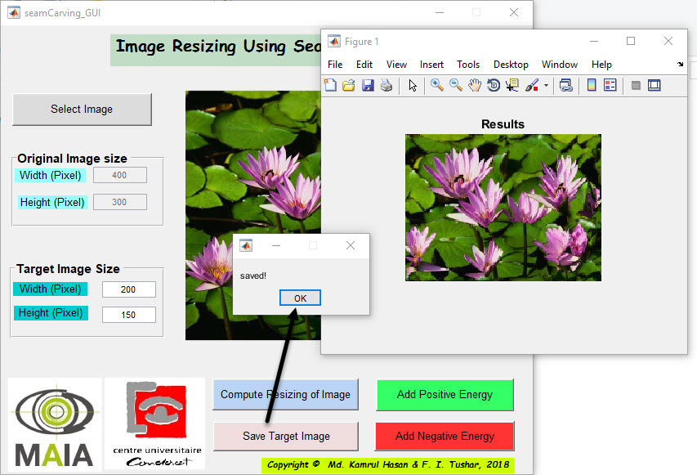
DESIGNED PROTOTYPE
Fig.5: Prototype of RTR Module.

Slide 20
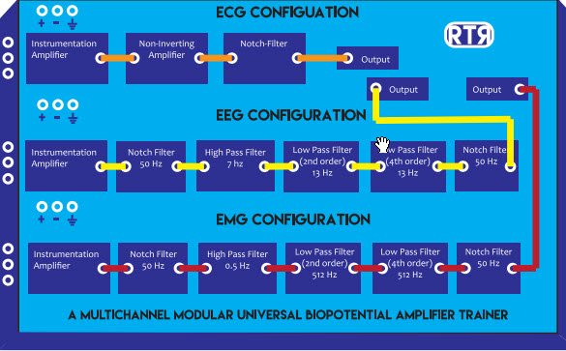
HAND-ON DESIGNING EXPERIENCE
Fig.6: Connection configuration.

Slide 21
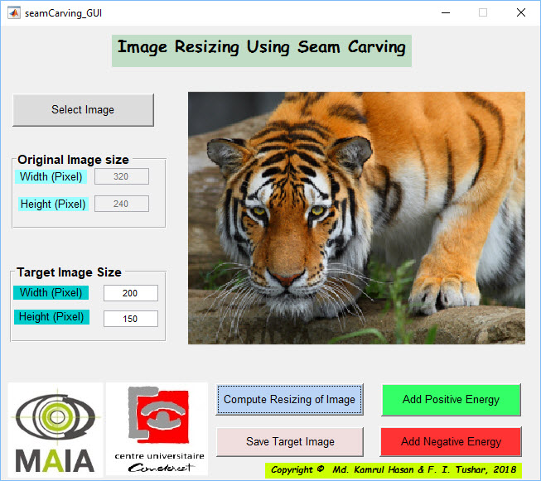
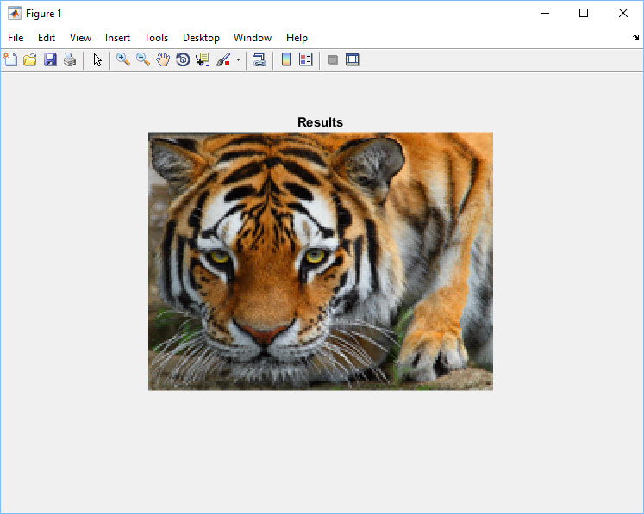
Results
a) RTR Module.
b) Breadboard filter design
Fig.7: Seam Removing.

Slide 22
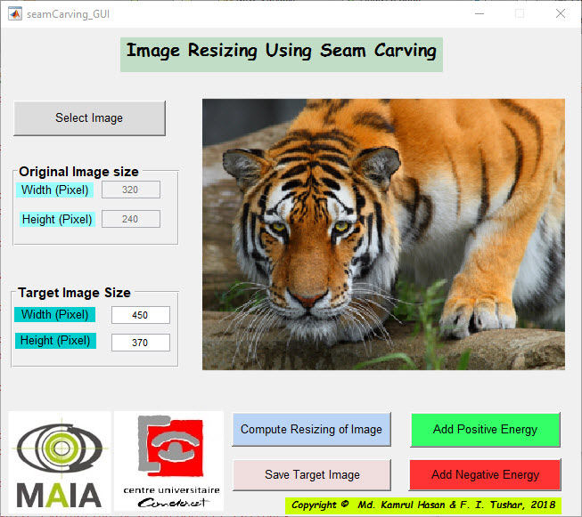

Results
a) RTR Module.
b) Breadboard filter design
Fig.7: Seam Adding / Image Enlarging.

Slide 23
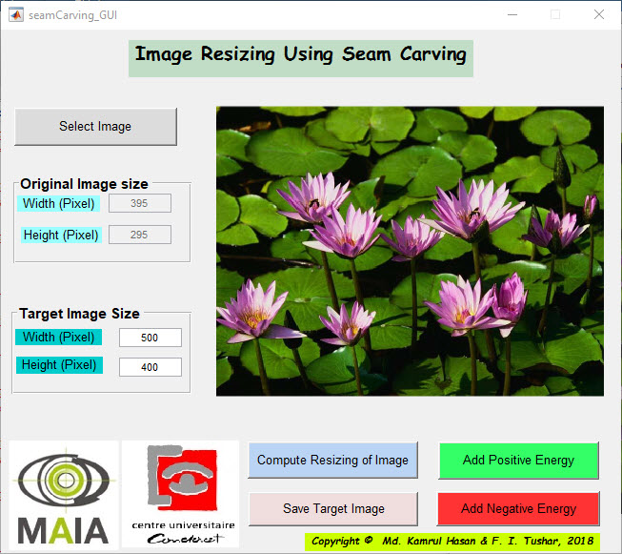
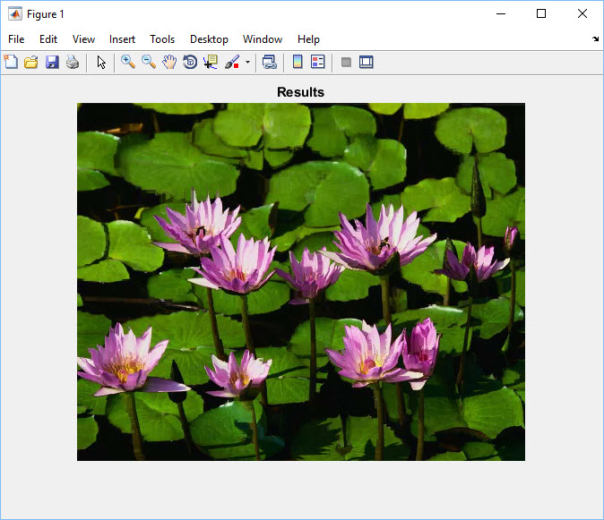
Results
a) RTR Module.
b) Breadboard filter design
Fig.7: Connection configuration with circuit made in breadboard.

Slide 24
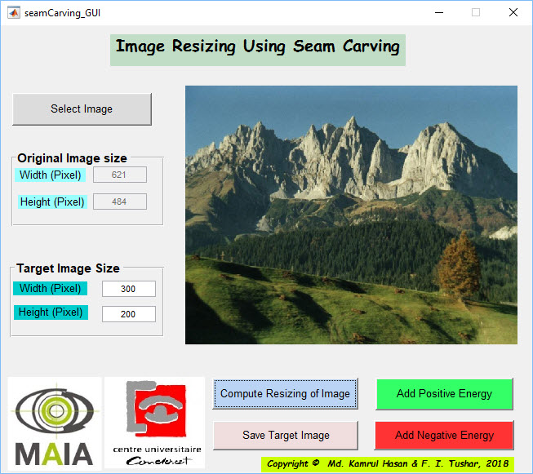
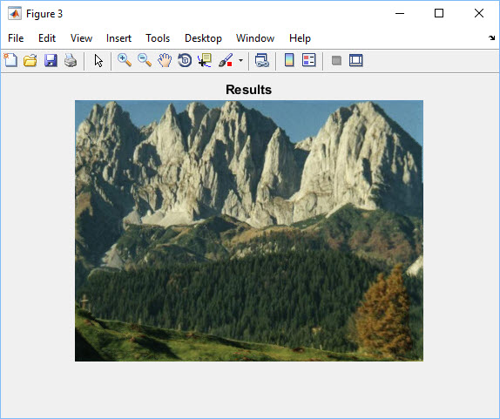
Results
a) RTR Module.
b) Breadboard filter design
Fig.7: Connection configuration with circuit made in breadboard.

Slide 25


Original Vs Seam Carving
a) RTR Module.
b) Breadboard filter design
Fig.7: Connection configuration with circuit made in breadboard.

Slide 26

Original Vs Cropped Image
a) RTR Module.
b) Breadboard filter design
Fig.7: Connection configuration with circuit made in breadboard.

Slide 27
Original Vs Cropped Image
a) RTR Module.
b) Breadboard filter design
Fig.7: Connection configuration with circuit made in breadboard.

Slide 28
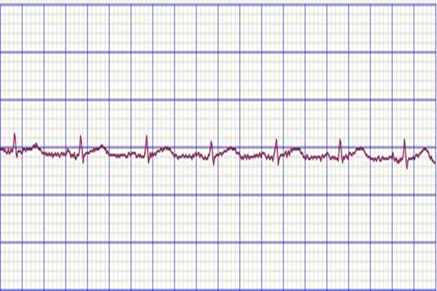
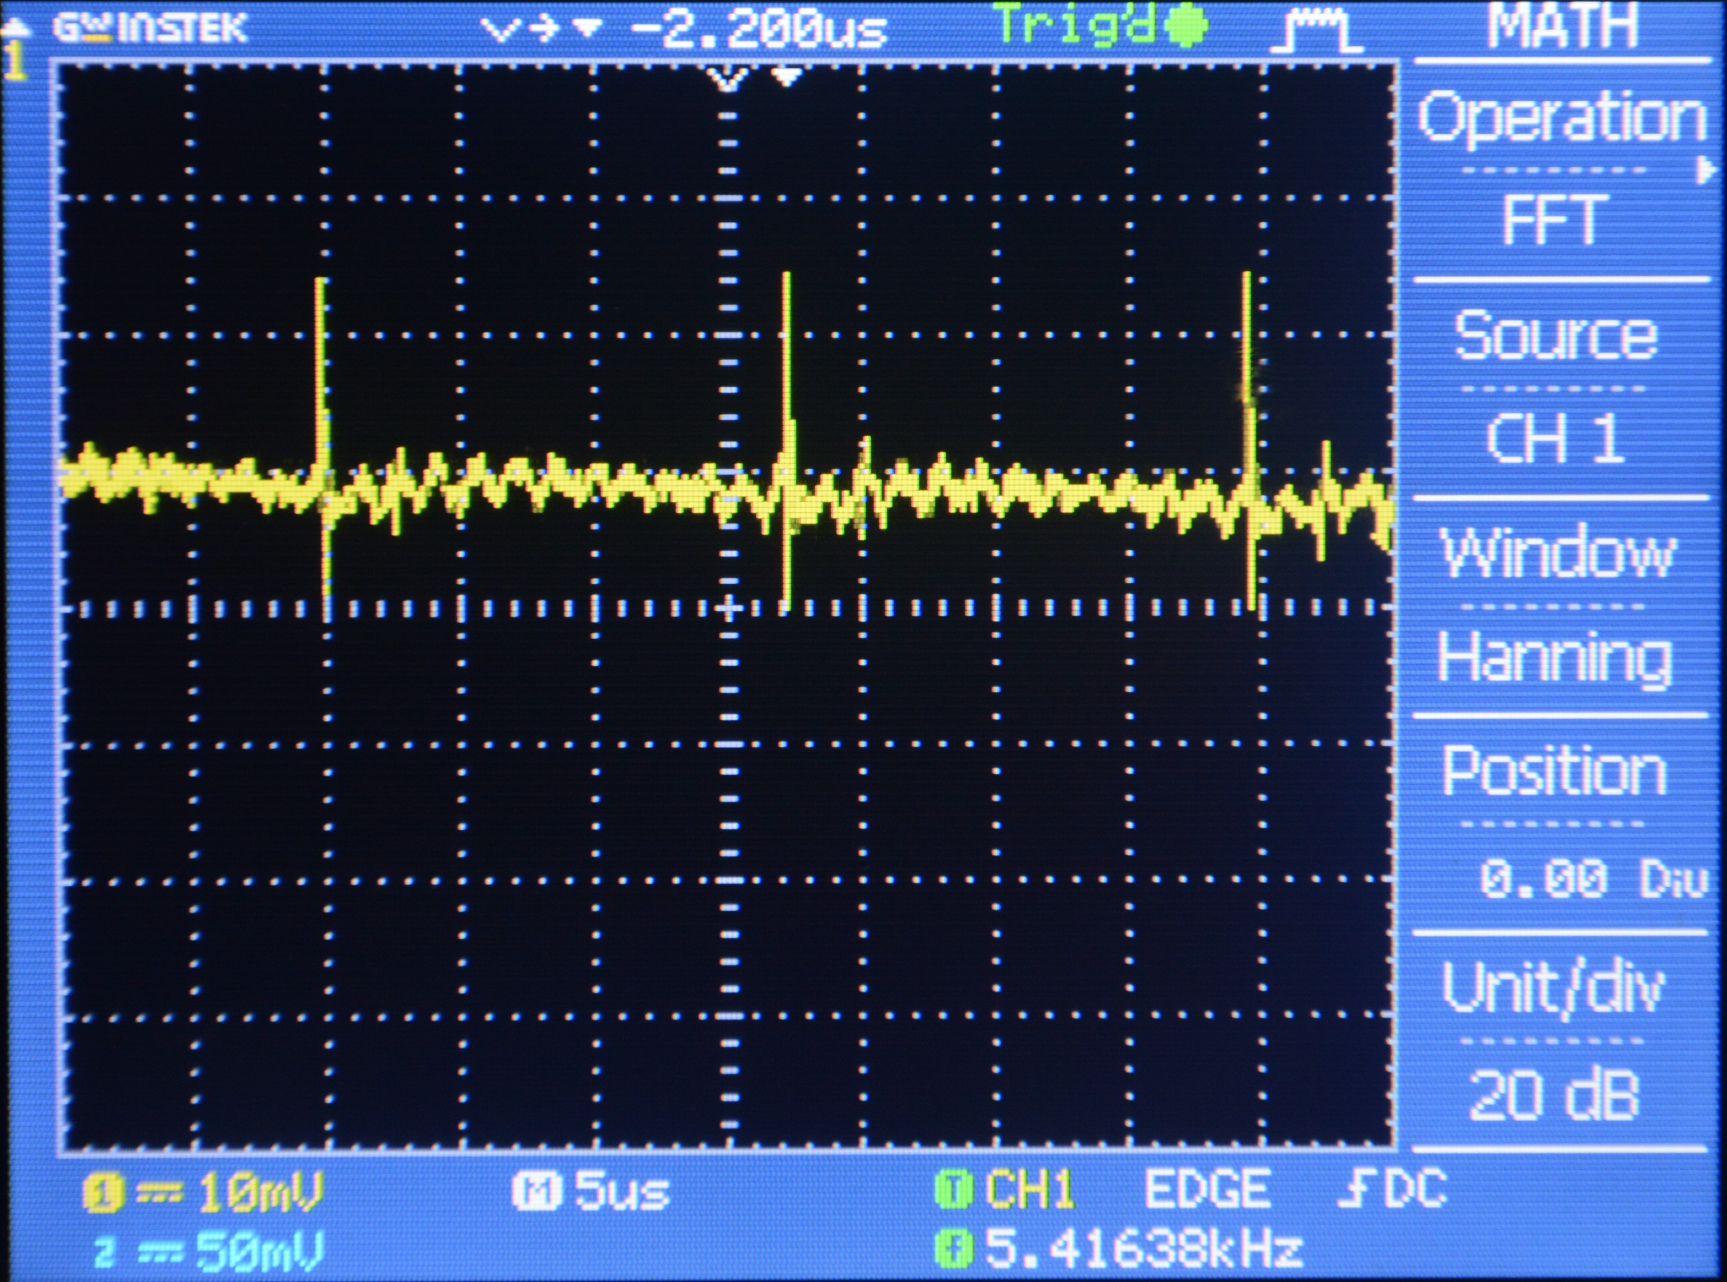
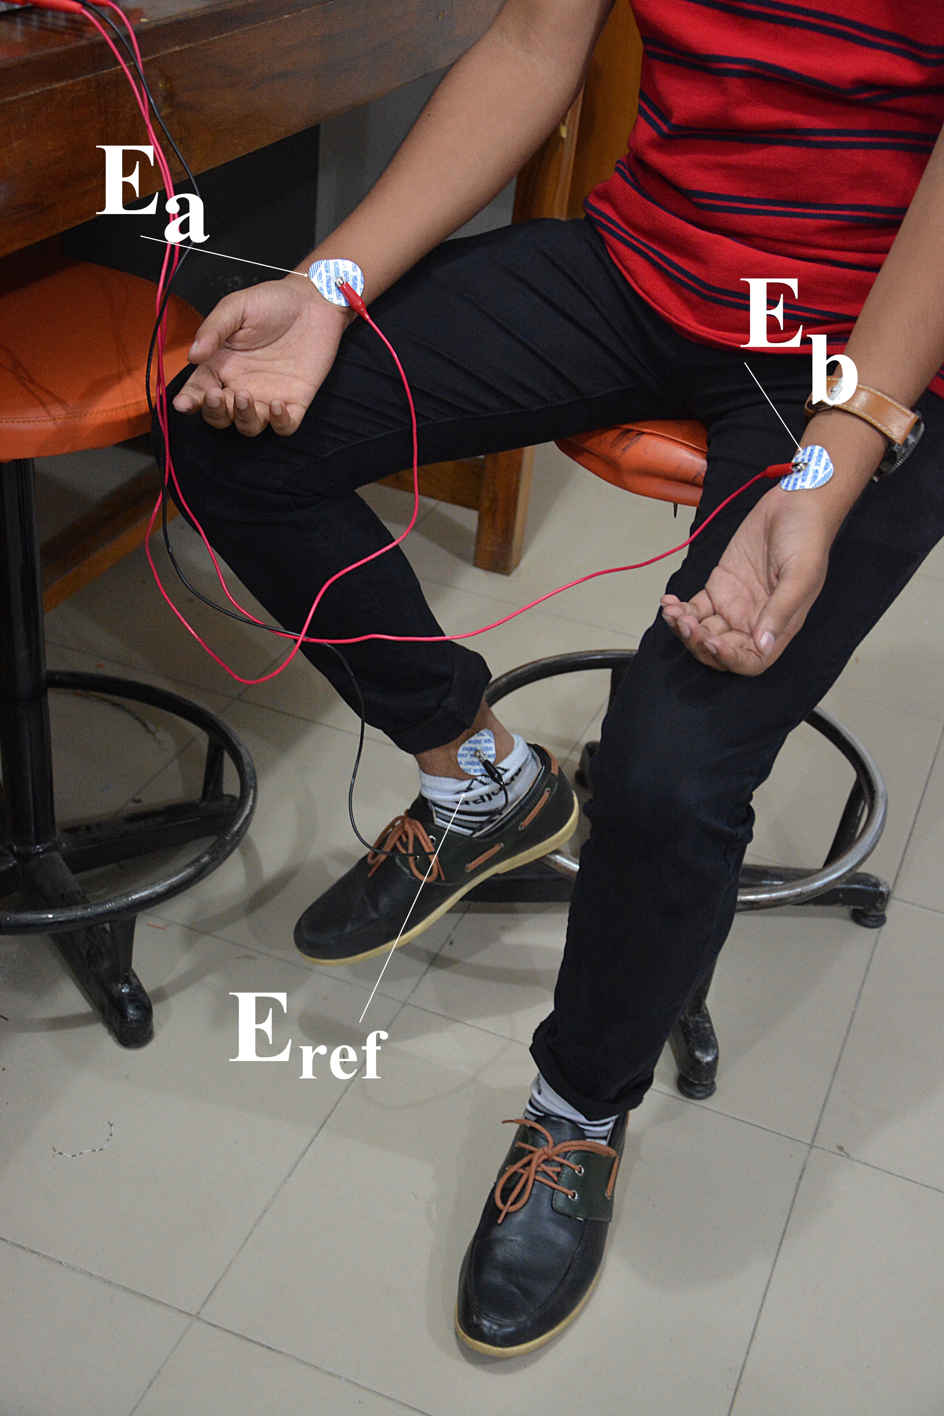
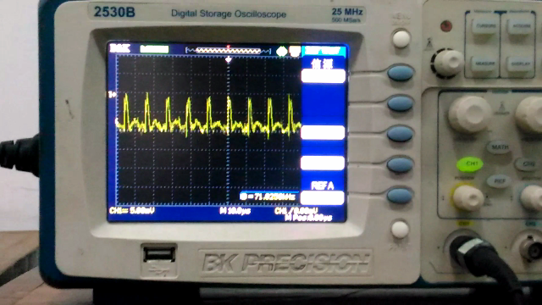
ECG MEASUREMENT
(c) ECG output.
(b)Non-clinical experimental output collected from Bi-Beat[2].
(a) Electrode placement.
Fig.8: ECG measurement.
(d) ECG output.

Slide 29
Cost
Equipment | Cost (TAKA)
PCB Printout and Soldering | 3500
RTR Box | 2500
Op-Amps | 2000
Circuit Equipment | 2000
Electrodes and other wires | 1000
Data Acquisition system | 800
Total | 11800TK / $143

Slide 30
Future Improvement
For

Slide 31
Reference
[1] The Biosignal How-To [BPM biosignals]. 2016. The Biosignal How-To [BPM biosignals]. [ONLINE] Available at: http://biosignals.berndporr.me.uk/doku.php?id=start. Accessed 01 May 2016.
[2] BiBeat. 2016. 12 lead ECG | BiBeat. [ONLINE] Available at: http://bibeat.com/product/12-lead-ecg/. Accessed 02 May 2016.
[3]O. O. Store, "R&D kit (16-channel) — 32bit, daisy, & accessories," OpenBCI Online Store, 2016. [Online]. Available: http://shop.openbci.com/collections/frontpage/products/openbci-16-channel-r-d-kit?variant=785215991. Accessed: Dec. 28, 2016.
[4] [Online]. Available: https://www.biopac.com/product/ecg-electrocardiogram-amplifier/. Accessed: Dec. 28, 2016.
[5] M. E. Ltd, "Mega electronics Ltd," 2016. [Online]. Available: http://www.megaemg.com/products/. Accessed: Dec. 28, 2016.

Slide 32
Thank you !!!☺

Slide 33
ANY Question ???☺

